Slide 1
http://elibraryusa.state.gov

Slide 2
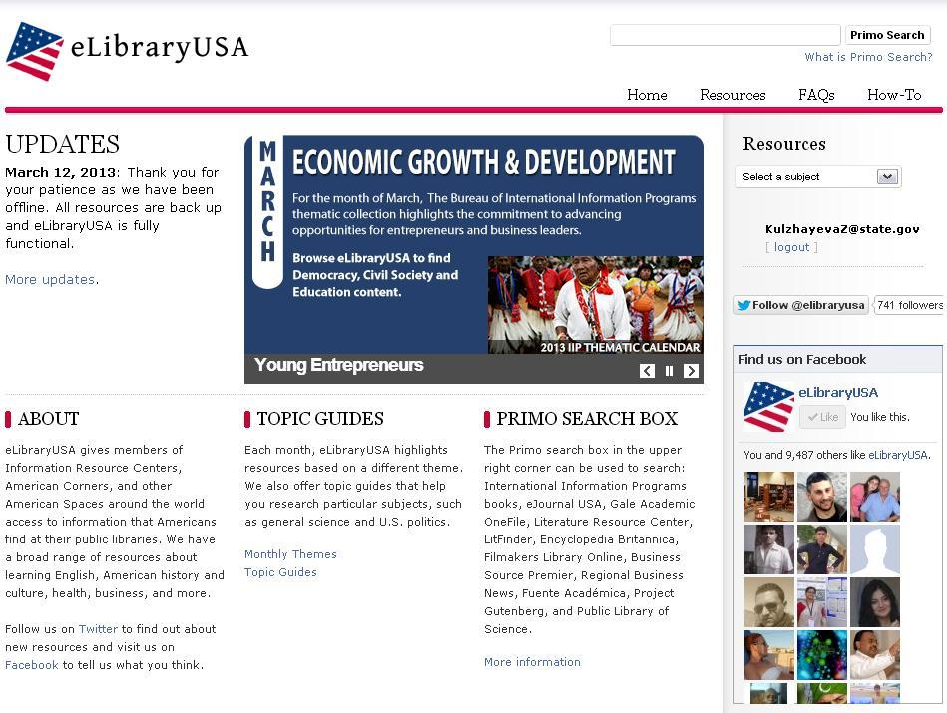

Slide 3
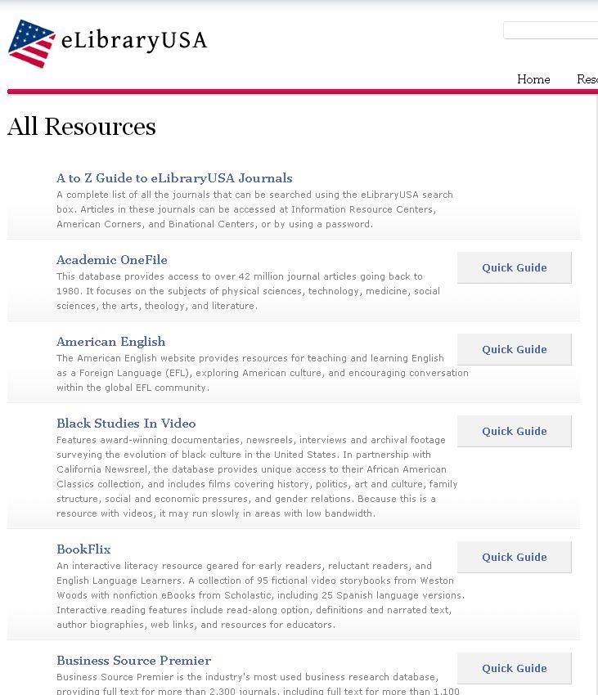

Slide 4
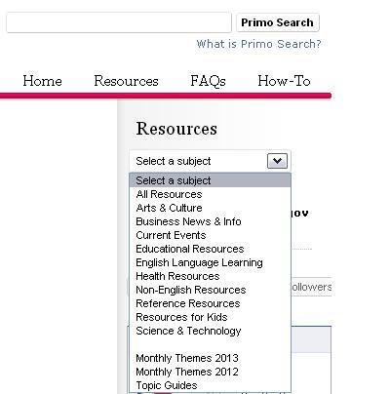

Slide 6
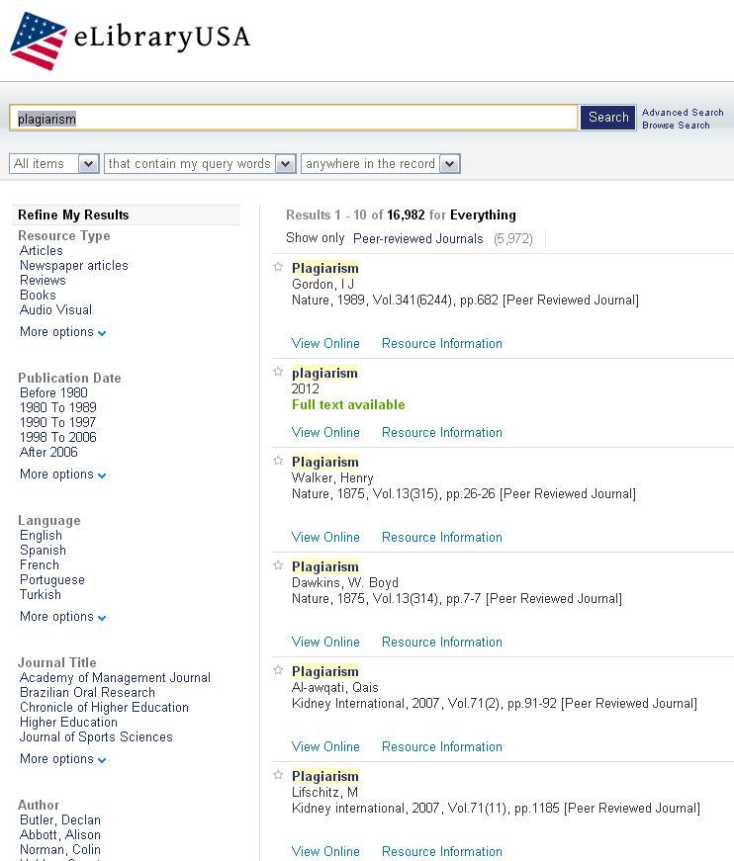

Slide 7
Send your questions to : U.S. Embassy Astana - IRC
ircastana@usembassy.kz

